Slide 1



AI-DRIVEN JOB INTERVIEW ANALYZER
Short Title: Interview Den (S25-47-D)
Team: Hamza Saeed 21i-0671
Waleed Saeed 21i-1672
Asad Ullah Shah 21i-0545
Supervisor: Dr. Mehreen Alam

Slide 2

Project Overview

Slide 3
Type of Project: Development
Company Name: Developers Den
Project Focus:
The AI-Driven Job Interview Analyzer aims to automate and optimize the hiring process by leveraging AI.
It provides an efficient, unbiased, and transparent evaluation system for both companies and candidates.

Slide 4
Hiring is slow, biased, and inefficient, with manual resume screening and lengthy interviews delaying talent acquisition.
Candidates face all sorts of uncertainty due to human error.
An AI-driven solution is needed to automate this process, ensuring a faster, fairer, and more effective hiring process.
Problem Statement

Slide 5
As students ourselves who have experienced tedious and often superficial interviews, we understand the challenges of finding a job through a fair and effective process.
Our AI-driven interviewer aims to make job opportunities more accessible by providing a more objective, unbiased, and efficient interview experience for candidates like us.
Motivation

Slide 6
Competitors
RozeeGPT
AI-Generated Job Descriptions
Candidate Filtering
Screening Tools
Proactive Matching via WhatsApp
Their platform is overly complex, whereas ours is straightforward, focused, and delivers a streamlined user experience.

Slide 7

Project Scope

Slide 8
Our AI-driven interviewer streamlines recruitment by automating resume screening, test creation, and interview monitoring, ensuring a faster and fairer hiring process.
Designed for students, job seekers, and companies, it leverages AI for objective evaluation, real-time assessments, and customizable scoring.
With dedicated company and candidate portals, it simplifies job applications, talent acquisition, and decision-making, making hiring more efficient, transparent, and unbiased.

Slide 9
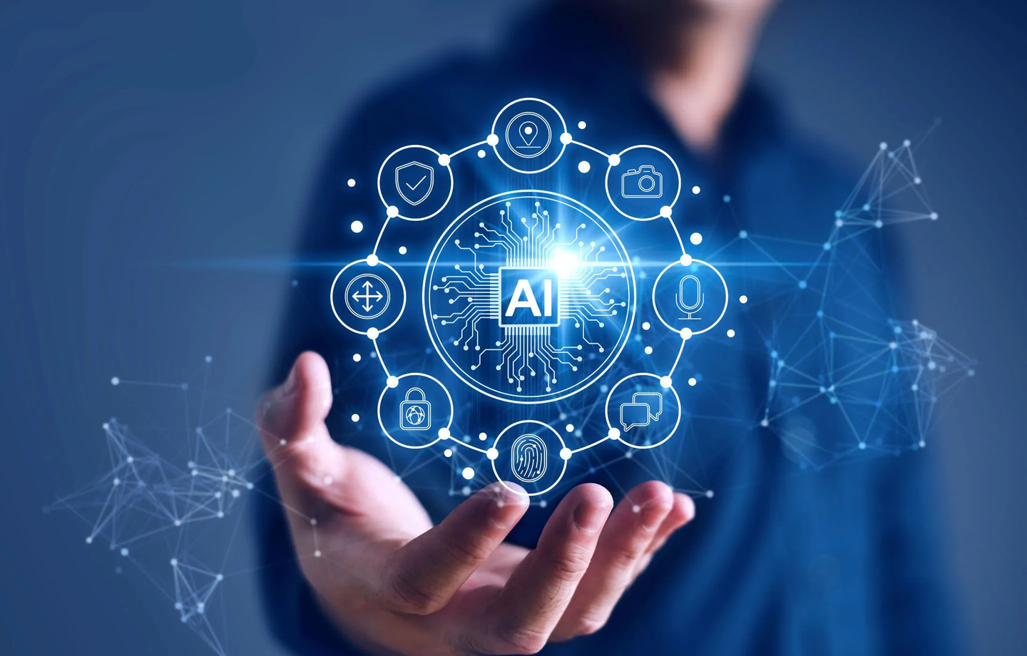
High-Level Features

Slide 10
1. AI Resume Screening
Objective: Automate resume evaluation for efficient job matching.
Implementation Options:
Standardized Parsing: Convert various CV formats into a structured template for analysis.
Scoring:
Assign a CV Score based on job requirement fulfillment.

Slide 11
2. AI Test Creation
Objective: Generate dynamic, AI-powered tests customized to job roles.
Features:
AI-generated customized questions based on job descriptions.
Option for companies to add their own questions and set difficulty levels.
Test Stages:
Basic Aptitude – General knowledge assessment.
Technical Questions – Role-specific skills evaluation.

Slide 12
3. AI Interview & Test Monitoring
Objective: Ensure fair, real-time evaluation through AI-assisted monitoring.
Features:
Real-time test proctoring and AI-based response analysis.
Evaluate technical, communication, and soft skills for a holistic assessment.

Slide 13
4. AI-Based Scoring & Insights
Objective: Provide an unbiased, transparent evaluation process.
Scoring Components:
Resume Screening – CV relevance scoring.
Quiz & Technical Test – Knowledge and skills validation.
AI Interview – Communication and problem-solving assessment.
Customization & Reporting:
Companies can prioritize specific criteria (skills, experience, etc.).
Visualized recruitment pipeline with detailed reports for hiring decisions.

Slide 14
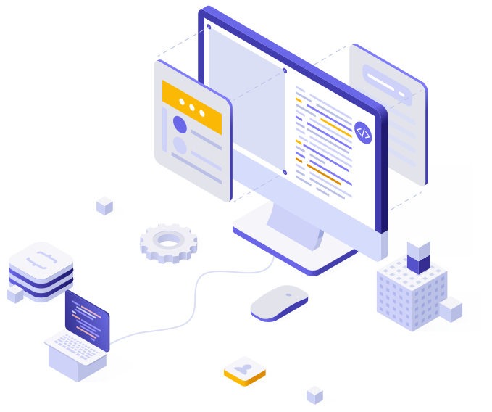
5. Portals
Objective: Ensure ease of use, and accessibility for both recruiters and job seekers.
Company Portal
Create Job Postings
Create & Manage Tests
Candidate Metrics
Candidate Portal
Job Dashboard
Live Progress Tracking
Constructive Feedback

Slide 15
Faster Hiring Process
Higher Quality Hires
Reduced Recruitment Costs
Improved Candidate Experience
Data-Driven Hiring Decisions
Scalable Global Recruitment
Expected Outcomes

Slide 16
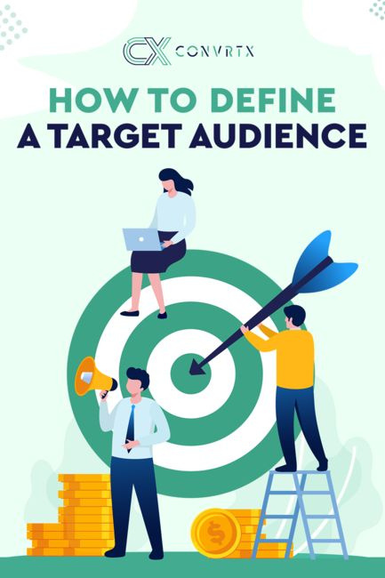
Uses and Impact
Uses:
Streamlined Recruitment Process
Enhanced Candidate Matching
Instant Feedback for Candidates
Cost-Effective Recruitment
Data-Driven Decision Making
Impact:
Improved Hiring Efficiency
Lower Employee Turnover
Increased Job Seekers’ Confidence
Optimized Resource Allocation
Global Reach and Scalability

Slide 17
Timeline
Iteration 4
NOV - DEC
User testing
Complete Portal
Complete AI Systems integration
Scoring and Ranking Systems
Real-Time Feedback
model finetuning
Final testing
Iteration 2
APR-MAY
Model training
Testing
Fully Developed Frontend
Basic Backend Functionality
AI-Generated Test Creation
Iteration 1
JAN-MAR
Data collection & preprocessing
Poster making
Initial testing
AI-Powered Resume Screening
Frontend UI/UX Figma Designs
Iteraton 3
SEP-OCT
Fully functional Portals
Basic Setup of AI Systems
Scoring System Implementation
Testing
Initial rollout
Cloud deployment

Slide 18
Work Distribution
Waleed Saeed
Data Preprocessing
Resume Screening AI
Test Creation AI
Interview AI
AI Integration
Testing
Asad Ullah Shah
UI/UX Design
Company Portal Frontend
Test Creation AI
Backend Development
Cloud Deployment
Testing
Hamza Saeed
Candidate Portal Frontend
Resume Screening AI
Scoring System
Analytics Dashboard
System Integration
User Testing

Slide 19
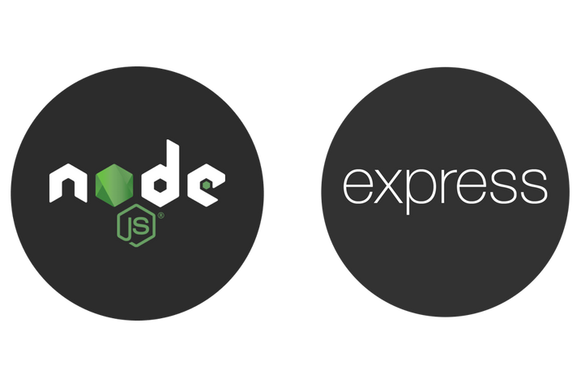
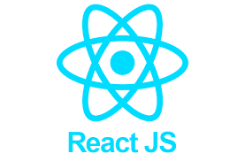


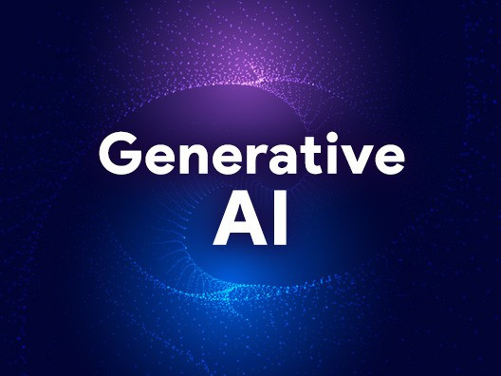

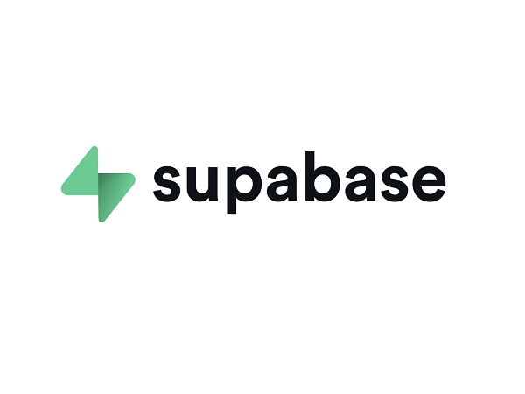
Tools
React
Node JS
Express
Flask API
SupaBase (Cloud)
LangChain LLM
Gen AI
NLP

Slide 20
Thank you!
Any Questions?

Slide 21
References
References for Your Proposal:
Harvard Business School. (2023, June 16). Actively Addressing Unconscious Bias in Recruiting. Retrieved from https://www.hbs.edu/recruiting/insights-and-advice/blog/post/actively-addressing-unconscious-bias-in-recruiting
Caccavale, J. (2022, October 28). Recruitment Bias Report: How Bias Affects Hiring & How to Remove It. Applied. Retrieved from https://www.beapplied.com/post/recruitment-bias-report-how-bias-affects-hiring-and-how-to-remove-it
Reference for Dataset:
Khalil, Y. (2023). Resumes Images Dataset. Kaggle. Retrieved from https://www.kaggle.com/datasets/youssefkhalil/resumes-images-datasets

